Slide 1
Architectural patterns

Slide 2
Architectural patterns
Patterns:
a way of representing, sharing and reusing knowledge about software systems.
described using narrative descriptions or diagrams.
Must include the pattern’s strength and weaknesses.
Pattern description include:
Pattern name
Brief description
Graphical model
Example of a relevant system where that pattern have already been used.
When to use that pattern , pros & cons of the pattern.
The fundamental idea behind arch. is separation of concern and data independence. Because it is beneficial for incorporating the localized changes only.
We will discuss some widely used architectural patterns.

Slide 3
MVC
Split application into multiple sections all have own purpose
User sent request to controller
Controller being the middleman between model and view, processes the client request and sent to the Model
Model handles data logic, access database and does authentication/update/delete or whatever is needed to perform on data.
Controller pass the raw information received from model to view
View renders the data
Return to controller and controller send response to client
This is a way to segregate data presentation from data logic.

Slide 4
The Model-View-Controller (MVC) pattern summary
Name | MVC (Model-View-Controller)
Description | Separates presentation and interaction from the system data. MVC divides applications into 3 parts. (Separation of concerns) The Model component manages the system data and associated operations on that data. The View component defines and manages how the data is presented to the user. The Controller component manages user interaction (e.g., key presses, mouse clicks, etc.) and passes these interactions to the View and the Model.
Example | A figure in successive slides shows the architecture of a web-based application system organized using the MVC pattern.
When used | Used when: there are multiple ways to view and interact with data. the future requirements for interaction and presentation of data are unknown.
Advantages | Allows the data to change independently of its representation and vice versa. (adding a new view or changing an existing one might not affect the underlying data in the model) Supports multiple presentations of the same data (changes made in one representation reflected in all of them.)
Disadvantages | Can involve additional code and increase code complexity.

Slide 5
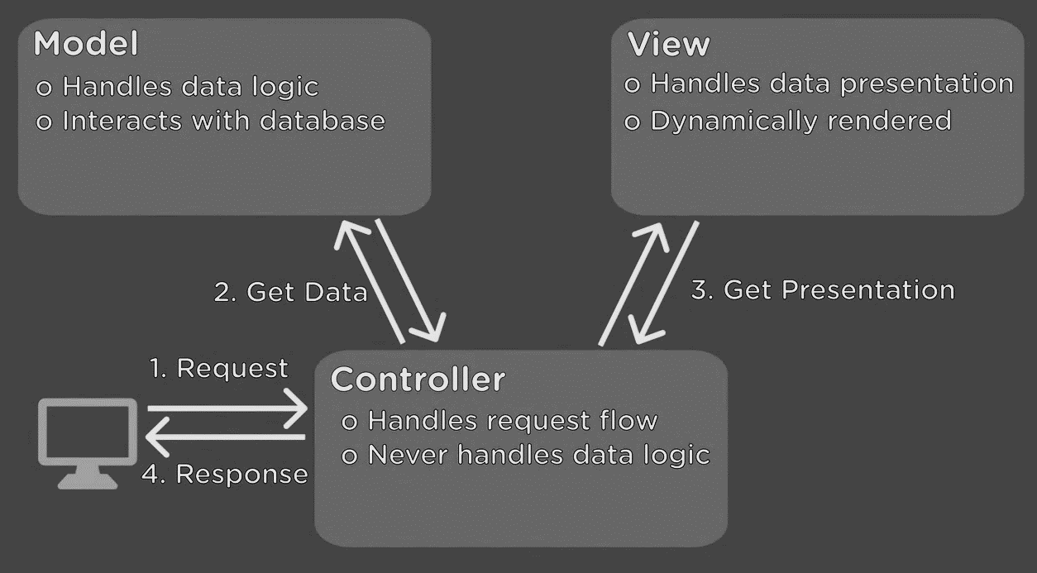
The organization of the Model-View-Controller

Slide 6
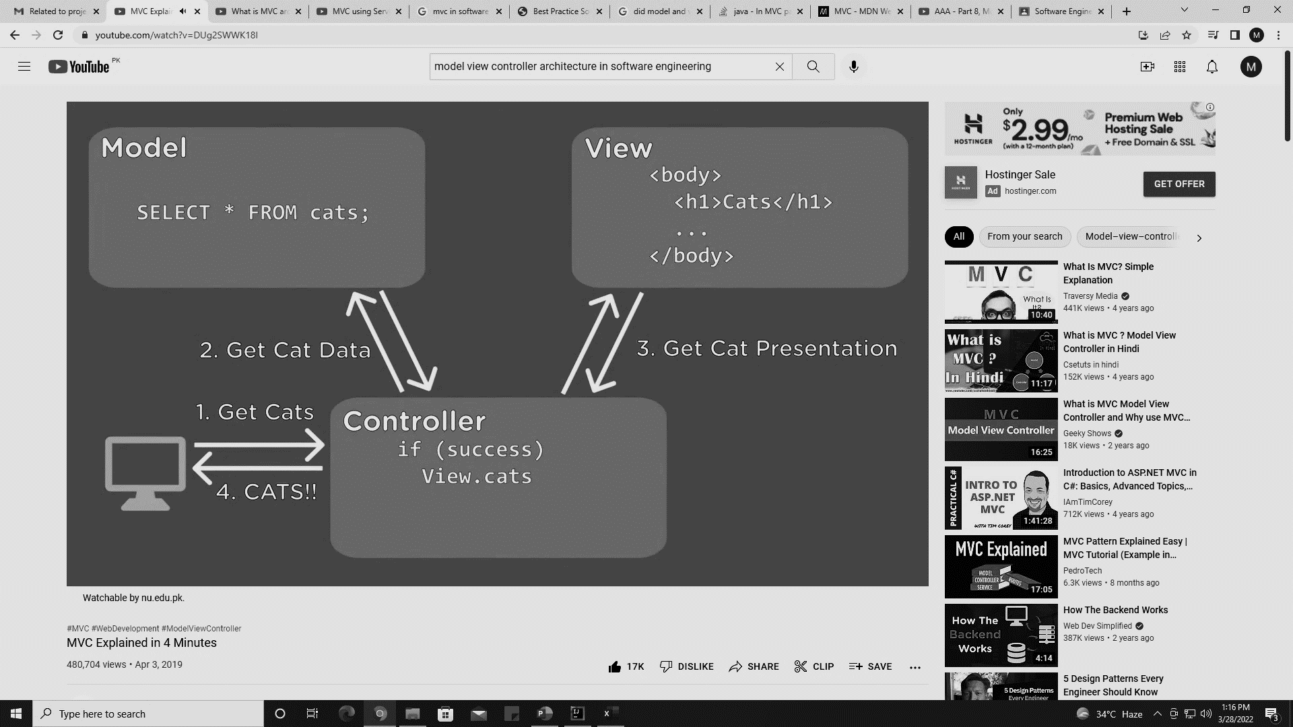
Example of MVC based web application

Slide 7

Example of MVC based web application

Slide 8
Layered architecture
Organises the system functionality into a set of layers each of which provide a set of services.
Typically, layers are UI, Auth & Authorization, Business logic, OS / DB
Every layer relies on facilities and services offered by the layer immediately beneath it.
Upper layer talk to layer below that, no jumping between layers is allowed
Lower layers never called to upper layer they just replied to the inputs from upper layer
Requesting something from a layer means iterating down to multiple layers
Structuring tasks into teams is easy as multiple teams may work for different layers.

Slide 9
Layered architecture
Advantages:
Easy to embed NFRs like security by inserting a layer without disrupting the whole system i.e., build on top-down approach
When a layer is updated, then only the adjacent layer is affected.
Easy to support multi-platform applications as only the machine-dependent layers need some changes to support multi-OS or databases.
Module replacement or upgradation is easy
Disadvantages:
performance is an issue as a request has to go over multiple layers for a reply
Its really difficult to code, like avoid going to specific layers
(creating this level of independence between layers is quite challenging).

Slide 10
The Layered architecture pattern summary
Name | Layered architecture
Description | Organizes the system into layers with related functionality associated with each layer. A layer provides services to the layer above it so the lowest-level layers represent core services that are likely to be used throughout the system.
Example | A layered model of a system for sharing copyright documents held in different libraries.
When used | Used when: building new facilities on top of existing systems; development is spread across several teams with each team responsibility for a layer of functionality; There is a requirement for multi-level security.
Advantages | Allows replacement of entire layers so long as the interface is maintained. Redundant facilities (e.g., authentication) can be provided in each layer to increase the dependability of the system.
Disadvantages | In practice, providing a clean separation between layers is often difficult and a high-level layer may have to interact directly with lower-level layers rather than through the layer immediately below it. Performance can be a problem because of multiple levels of interpretation of a service request as it is processed at each layer.

Slide 11
A generic layered architecture

Slide 12
The architecture of the iLearn system case study

Slide 13
Repository architecture
Sub-systems must exchange data.
This may be done in two ways:
Shared data is held in a central database or repository and may be accessed by all sub-systems.
Each sub-system maintains its own database and passes data explicitly to other sub-systems.
When large amounts of data are to be shared, the repository model of sharing is most commonly used as this is an efficient data-sharing mechanism.
It’s a static structure and doesn’t change at runtime. (difference from client-server architecture).

Slide 14
The Repository pattern
Name | Repository
Description | All data in a system is managed in a central repository that is accessible to all system components. Components do not interact directly, only through the repository.
Example | Examples are: Interactive Development Environment for software, MIS etc.
When used | When: large volumes of information are generated that has to be stored for a long time. In data-driven systems where the inclusion of data in the repository triggers an action or tool.
Advantages | Components can be independent—they do not need to know of the existence of other components. Changes made by one component can be propagated to all components. All data can be managed consistently (e.g., backups done at the same time) ~ central repository
Disadvantages | The repository is a single point of failure so problems in the repository affect the whole system. Distributing the repository across several computers may be difficult.

Slide 15
A repository architecture for an IDE

Slide 16
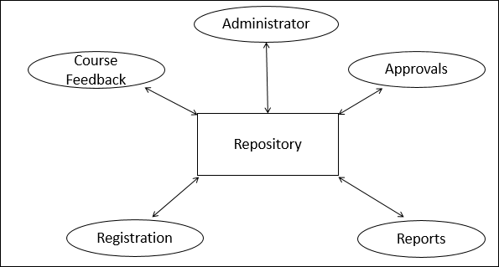
A repository architecture EXAMPLE

Slide 17
Client-server architecture
Runtime organization of distributed systems
A set of services mounted over associated servers and client access the services via servers.
Components:
A set of Servers: print server, file server, management server etc.
A set of clients: different instances of a client program running concurrently on multiple machines to access service offered by server.
Network: distributed system architecture using internet protocols
Client access services offered by servers via remote procedure invocation using request-reply protocols.

Slide 18
The Client-server pattern summary
Name | Client-server
Description | In a client–server architecture, the functionality of the system is organized into services, with each service delivered from a separate server. Clients are users of these services and access servers to make use of them.
Example | Generally used for web applications, email servers and file sharing systems
When used | Used when: data in a shared database has to be accessed from a range of locations. May also be used when the load on a system is variable.
Advantages | Resource sharing Independent servers No single point failure transparent system upgradation
Disadvantages | Each service is a single point of failure so susceptible to denial of service attacks or server failure. Performance may be unpredictable because it depends on the network as well as the system. May be management problems if servers are owned by different organizations.

Slide 19
A client–server architecture for a film library

Slide 20
Pipe and filter architecture
Functional transformations process their inputs to produce outputs (that’s why its called as filter).
May be referred to as a pipe and filter model (as in UNIX shell).
Variants of this approach are very common. When transformations are sequential, this is a batch sequential model which is extensively used in data processing systems.
Best for batch processing, embedded systems or systems with limited user interactions.
Not really suitable for interactive systems because the input data stream needs to be pre-processed. GUI based I/O systems have complex input streams like mouse click events, for which converting into sequential in out stream is challenging.

Slide 21
The pipe and filter pattern
Name | Pipe and filter
Description | The processing of the data in a system is organized so that each processing component (filter) is discrete and carries out one type of data transformation. The data flows (as in a pipe) from one component to another for processing.
Example | Coming figure is an example of a pipe and filter system used for processing invoices.
When used | Commonly used in data processing applications (both batch- and transaction-based) where inputs are processed in separate stages to generate related outputs. Compilers. The consecutive filters perform lexical analysis, parsing, semantic analysis, and code generation
Advantages | Easy to understand and supports transformation reuse. Workflow style matches the structure of many business processes. Evolution by adding transformations is straightforward. Can be implemented as either a sequential or concurrent system.
Disadvantages | The format for data transfer has to be agreed upon between communicating transformations. Each transformation must parse its input and unparsed its output to the agreed form. This increases system overhead and may mean that it is impossible to reuse functional transformations that use incompatible data structures.

Slide 22
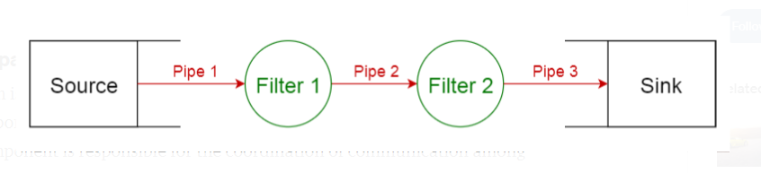
pipe and filter architecture

Slide 23
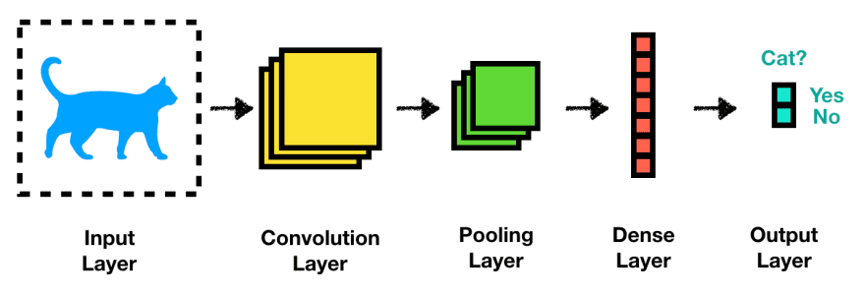
pipe and filter architecture example - object detection using CNN

Slide 24
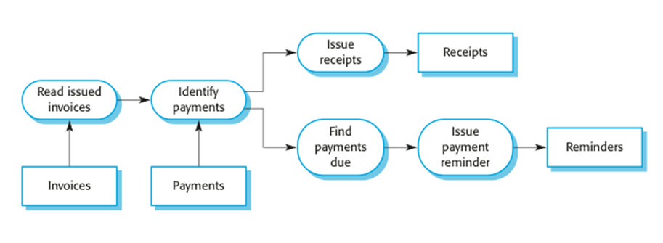
pipe and filter architecture example - payments system

